Slide 1
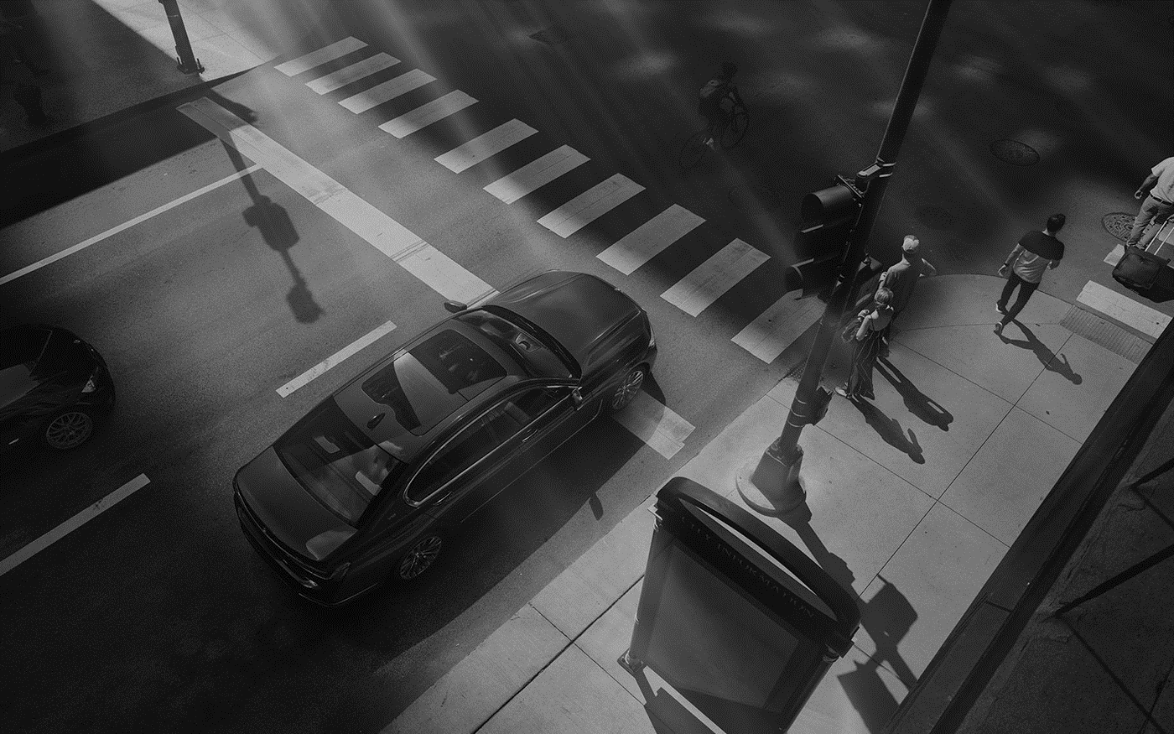


5G- ENABLED REMOTE ROAD FIXING VEHICLE WITH AUTOMATED DEFECT IDENTIFICATION BY AI VIDEO/IMAGE ANALYTICS
Final phase
ITU AI/ML in 5G Challenge
Smart Transportation

Slide 2
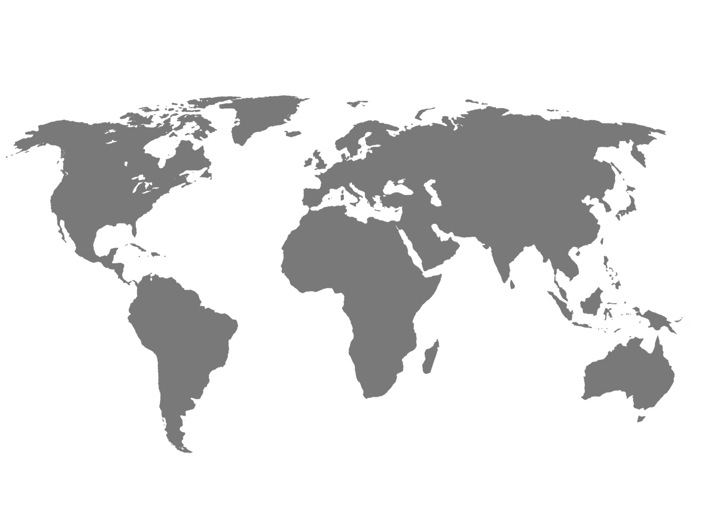




WE ARE
SAUDI ARABIA
Challenge of INDIA
Atheer K. Alsaif
EBU- Business development
Nora M. Almuhanna
EBU- Enterprise account
Abdullah O. Alwashmi
People Strategy & Experience
Abdulrahman Alromaih
Infrastructure Design
akalsaif@stc.com.sa
nalmuhanna@stc.com.sa
aoalwashmi@stc.com.sa
amalromaih@stc.com.sa

Slide 3
AGENDA
Challenge description
1
Solution
2
System design & data set
3
Relevance with automotive industry
4

Slide 4

REGION INSIGHT
2nd
8
largest road network in The World with length around 4,320,000 kilometers.
INDIA
Various type of transportation methods, lead to different challenges.
Bicycle, Motor Cycle, Car, Tempo, Bus, Train, etc.
4.3
M
4.3 m road accidents recorded across India in 2019. where the major cause of road accidents (driver behavior, road condition, distraction, etc.)
Source:
https://morth.nic.in/sites/default/files/Road_Accidents_in_India_2017.pdf

Slide 5

PROBLEM
STATMENT
Road condition
one of the main causes of road safety level around all around the world. This project seeks to improve road condition by address an new techniques for road quality inspection process and instance fixing through emerging technologies.

Slide 6
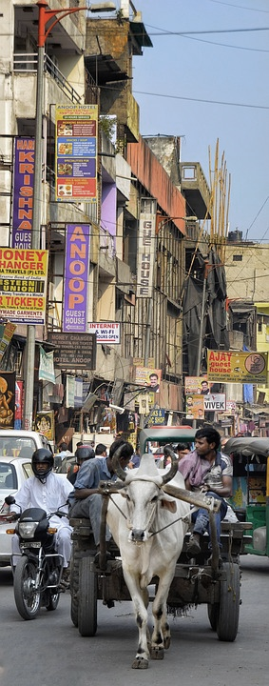
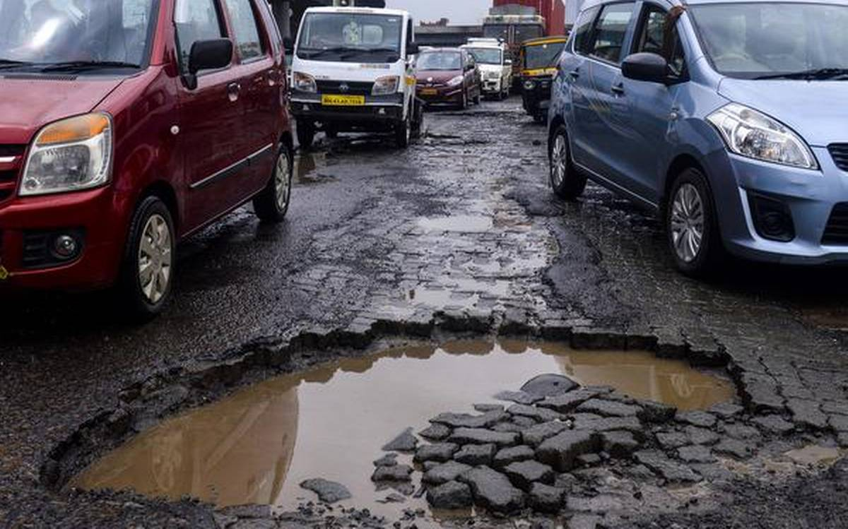
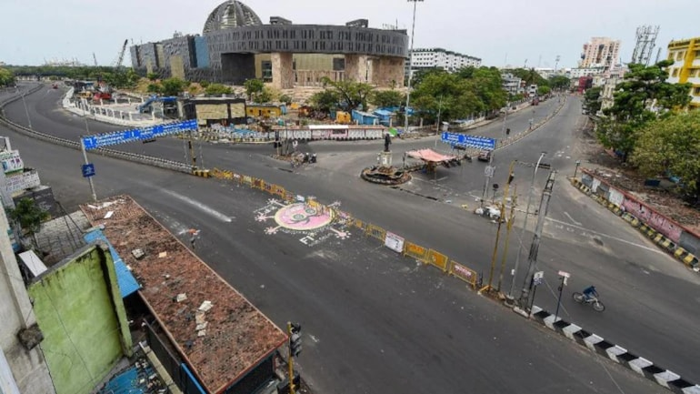
Challenges in Indian roads
“
Potholes
Lane marking
India has one of the most pothole stricken road networks. In 2017, potholes killed 3,597 people in India.
Newly surfaced roads with no lane markings are often seen by motorists as a green pass to speed and cut lanes. But most of roads have little or no markings and uneven signage.
Due to hitting a pothole - or taking the wrong measures to avoid one - can also lead to a crash resulting in injuries or worse. A blown tire or broken suspension part can cause you to lose control of your vehicle, as can a split-second decision to stomp on the brakes or suddenly swerve out of your lane to avoid a pothole.

Slide 7
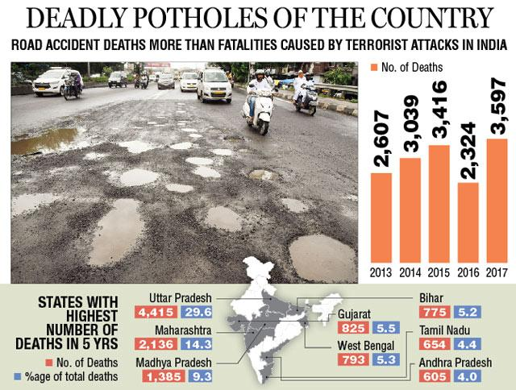
Challenges in Indian roads
“
Potholes killed 3,597 across India in 2017, terror 803
Source:
https://timesofindia.indiatimes.com/india/potholes-killed-3597-across-india-in-2017-terror-803/articleshow/64992956.cms

Slide 8


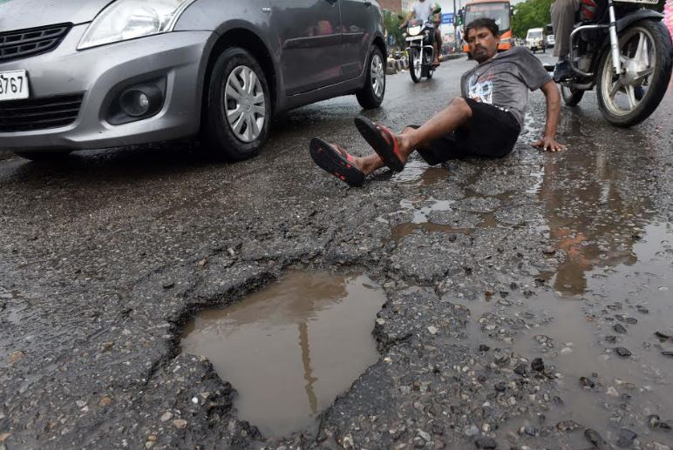
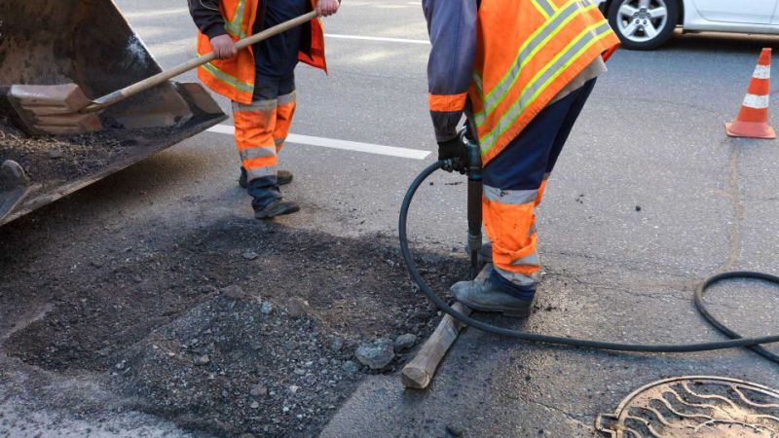
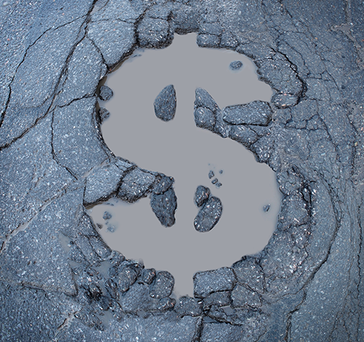
Challenges in Indian roads
“
Manual inspection inefficient and reliant on experts
Cost of challenges
2.8
Potholes are a major factor in causing axle & suspension failure, which counts for a third of mechanical issues on Mumbai roads and costs motorists an estimated Rs.2.8 million every year.
M Rs
50
Authorities currently pay out more than Rs.50 million in compensation claims due to poor roads.
M Rs

Slide 9
AGENDA
Challenge description
1
Solution
2
System design & data set
3
Relevance with automotive industry
4

Slide 10
NEW
METHODS &
TECHNOLGY
Project aims
The project involves the AI to identify road condition and using 5G to enable the remote repair of roads with the goal of reducing manpower and the expertise needed to fix potholes and road lane painting.
Notes:
صيانة الطرق والمحافظة عليها لا تقل أهمية عن تنفيذها

Slide 11


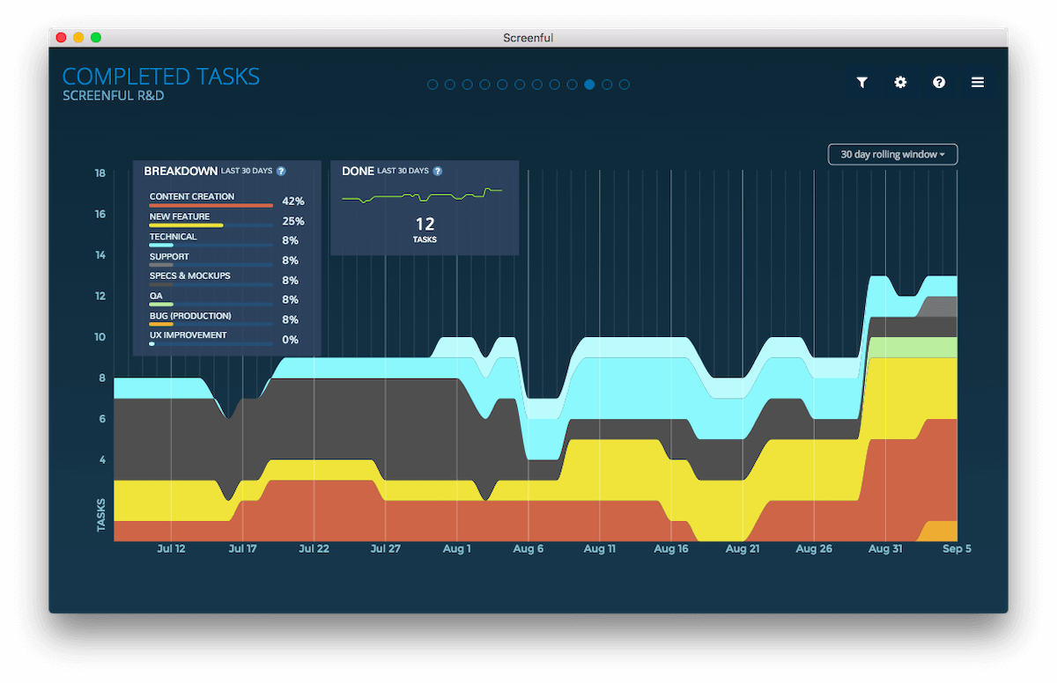
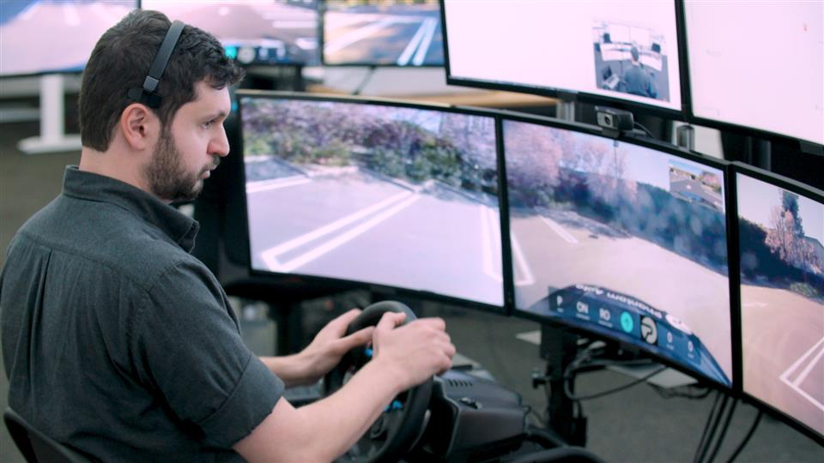
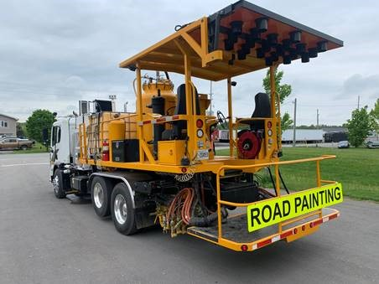
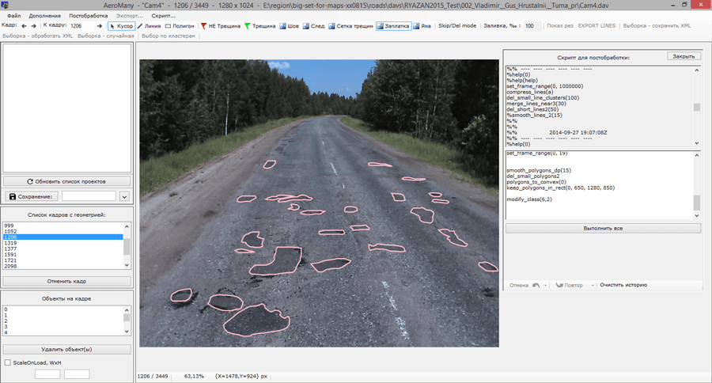


SOLUTION AT GLANCE
ARCHITECTURE
Surveillance and monitoring
Fixing road problems
Detection of road defects in real time
5G
Image analytics
By AI/Ml
Command Control Center
1. Monitoring road condition (Decision making)
2. Remote vehicle control Center owned/authorized by Gov
Construction vehicle
With GPS and communication model
Data gathering
Image/ video data can be from different sources
Send construction vehicle for identifies places
Notes:
To automate manual work of operators who search and select road defects from road laboratories video footage, like cracks, holes and patches.

Slide 12
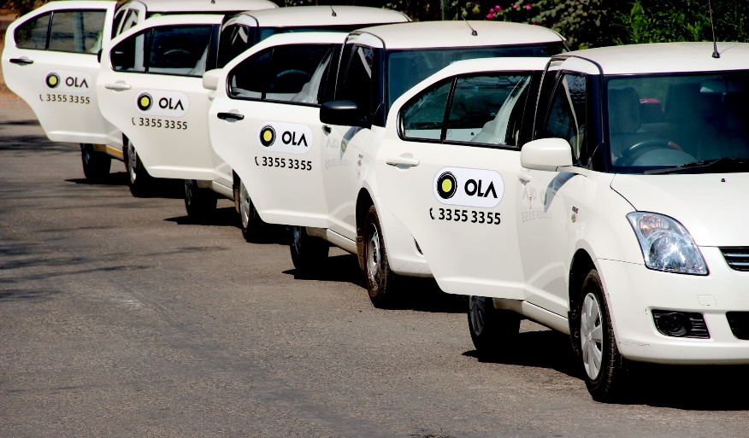
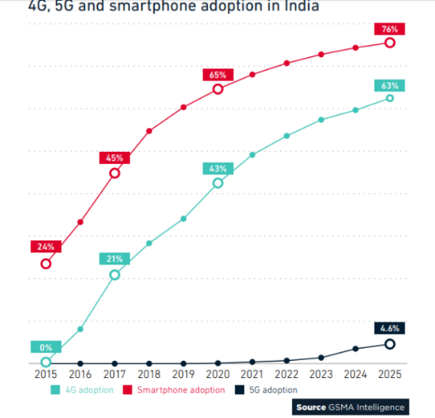
SOLUTION
AT GLANCE
Usability/Motivation
Over than 1 million trip per day leads to real time monitoring
India 5G coverage plan

Slide 13
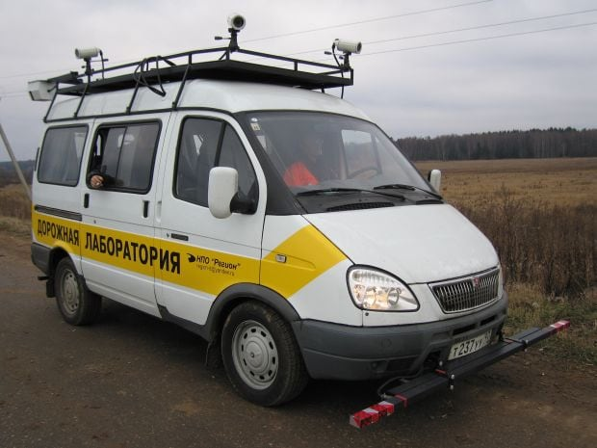
HOW 5G AND AI IS BEING USED IN SOLUTION
5G
High-definition video feeds from trucks can be sent back and distributed to the local control center via the 5G network and MEC for remote monitoring.
Control the vehicle remotely as a result the 5G network’s low latency.
AI
To automate manual work of operators who search and select road defects from road laboratories video footage, like cracks, holes and patches.
Source:
https://deepsystems.ai/solutions/road-defects-detection
https://www.gsma.com/greater-china/wp-content/uploads/2020/03/5G-Use-Cases-for-Verticals-China-2020.pdf

Slide 14
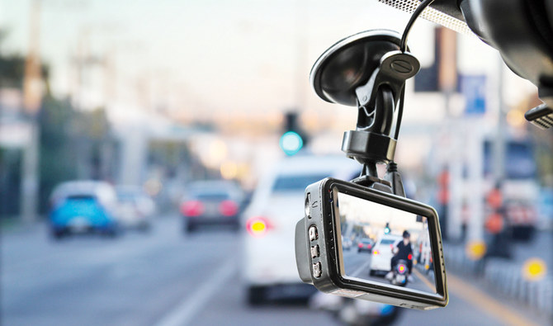
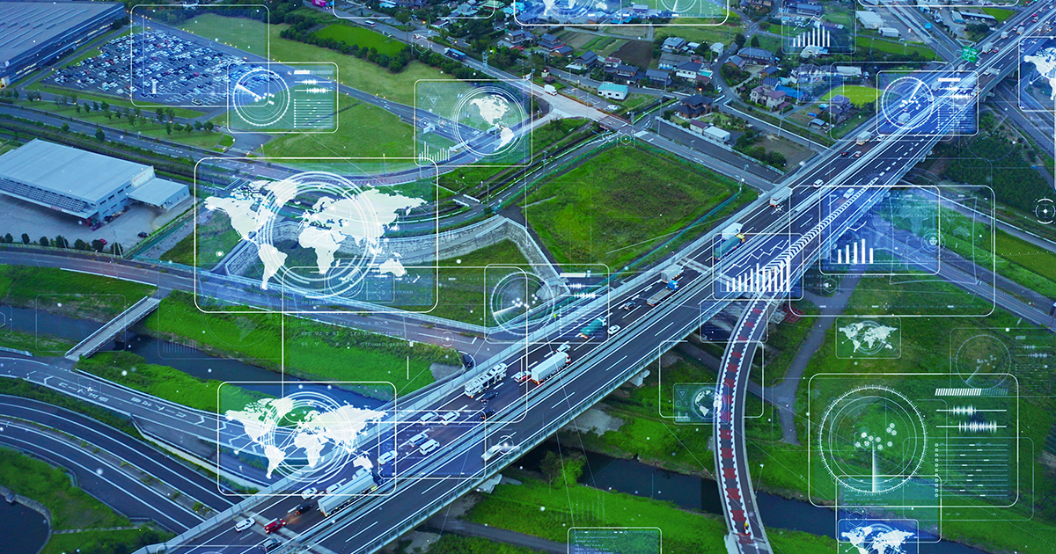





END USER DETAILS
Cam on vehicle
to detect road defects in real time
Road condition report
to report road defects in real time
Vehicle control center
Remote driving machine for road fixing

Slide 15









SOLUTION
AT GLANCE
ARCHITECTURE
Device/ Object
Connectivity
Data processing in the cloud
Application infrastructure
Police car
CCTV & IOT Sensor
Wireless access Point
LDC monitoring
Taxi
Radio Tower
Smart Phone
BUS
Physical Layer
Network Layer
Middleware Layer
Application Layer

Slide 16
GOALS TO BE ACHIEVED
1
Work efficiency
Project aims
2
Visible road lane and good road condition
3
Low car accidences
4
Decrease human risk

Slide 17
AGENDA
Challenge description
1
Solution
2
System design & data set
3
Relevance with automotive industry
4

Slide 18

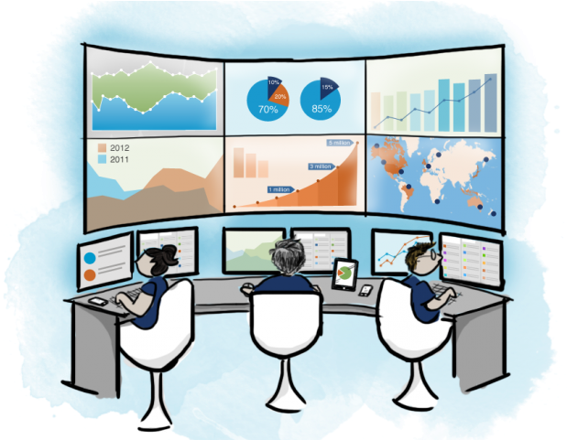
SOLUTION
Flowchart
4G
5G
Start
Collect videos and GPS using sensor unit
Send data to the VS
Fix the road
Road
Analyze Data
(AI)
Send notification to the CC (Mobile & Web app)
Update task status
Unstructured
Road
Yes
Virtual Server
No
Assign Repairing Task
Control the vehicle Remotely
Control Center
End

Slide 19


AI checks street
AI checks street
Use case diagram/Flow chart
Sabotaged
No
Finish
Yes
Remote Construction Vehicle
System
Design and
Data set

Slide 20
Evaluation Setup & Timeline
Metrics to be used (Quantitative and Qualitative)
Quantitative
Qualitative
# of covered roads
To measure the roads covering by setting the covering baseline and target
Road color/slop after repairing
To measure the overall work done in repairing defects and compare it with the ideal work
% of defects repaired
Customer satisfaction survey
To see what customers think of the work done and the solution impact
To measure the percentage of repairing the identified defects
# of vehicles detect road defects in real time
To measure the efficiency of vehicles which will detect the defects and their ability to do the work
Focus groups
To see what customers think of the work done and the solution impact
% of time consumed in defects repairing
Individual Interview
To measure the real time per defect repairing
To see what customers think of the work done and the solution impact

Slide 21
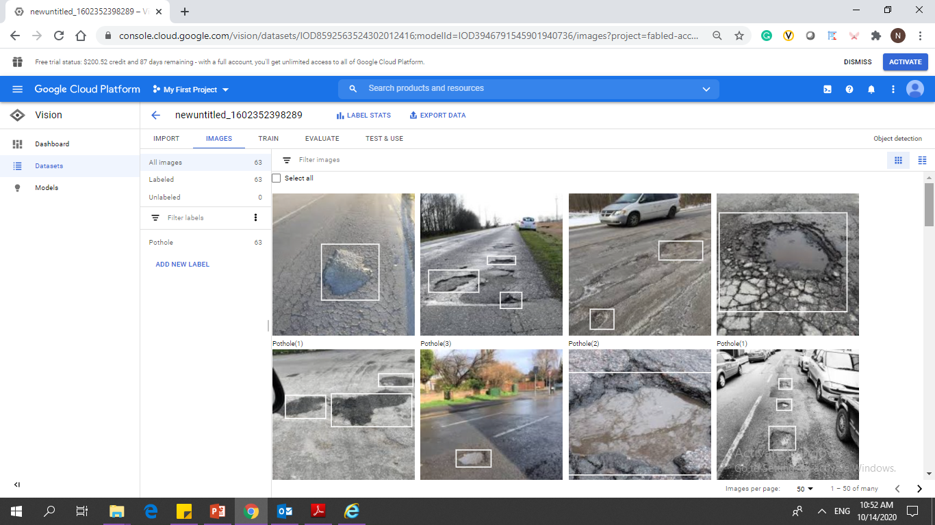


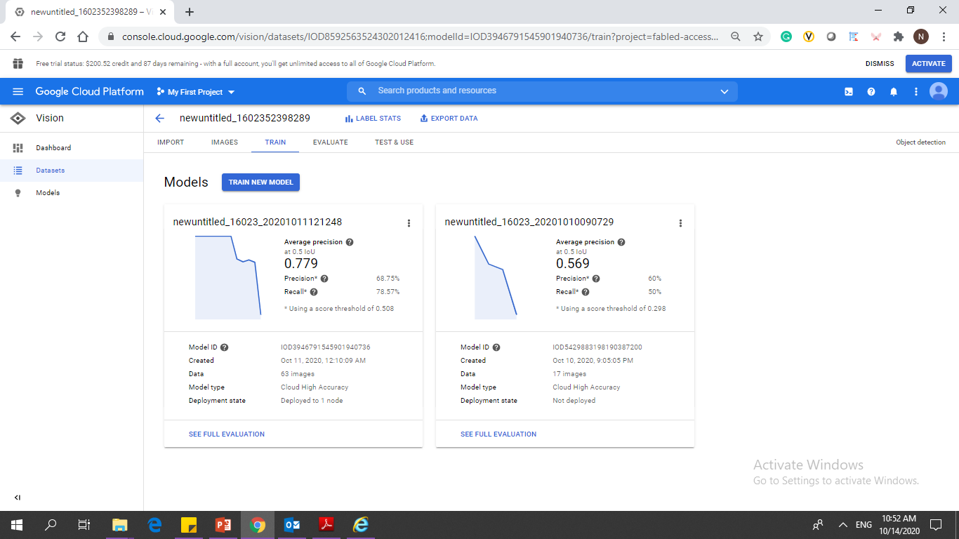
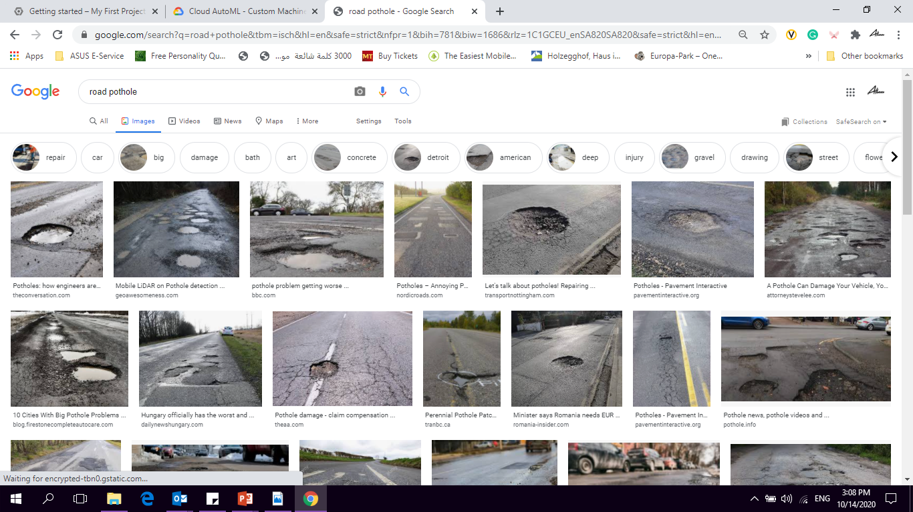
Analyze Data
(AI)
Cloud AutoML
Batch Image Download Full Screen Capture

Slide 22
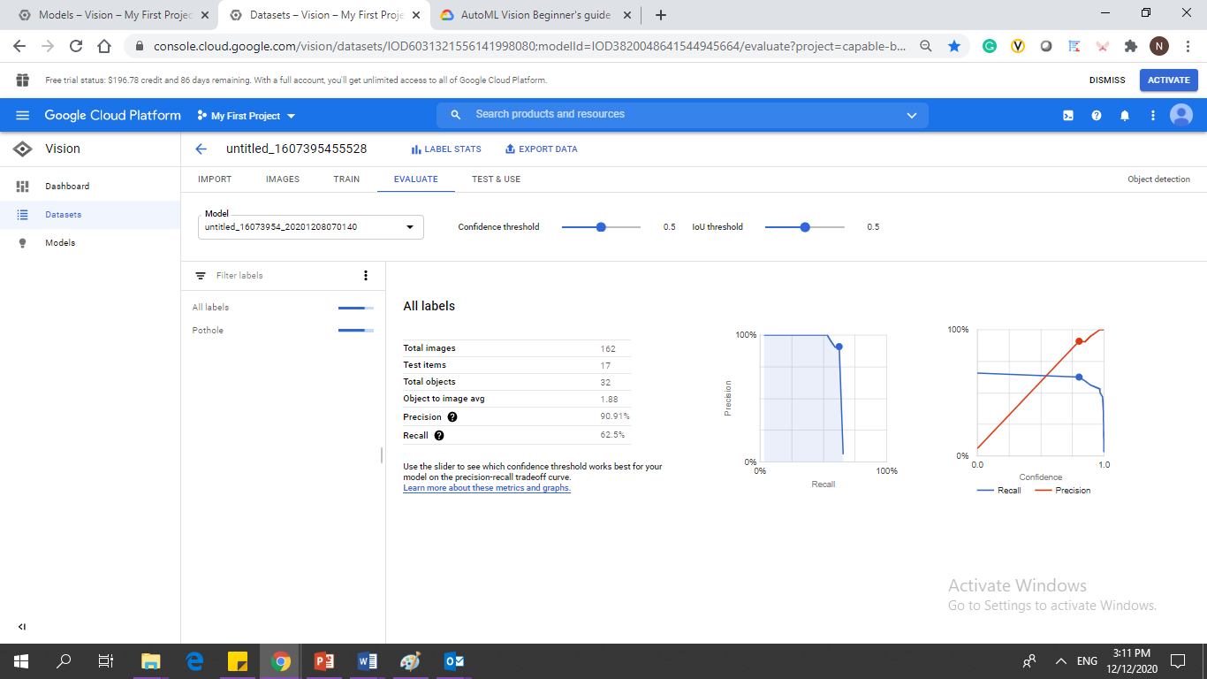
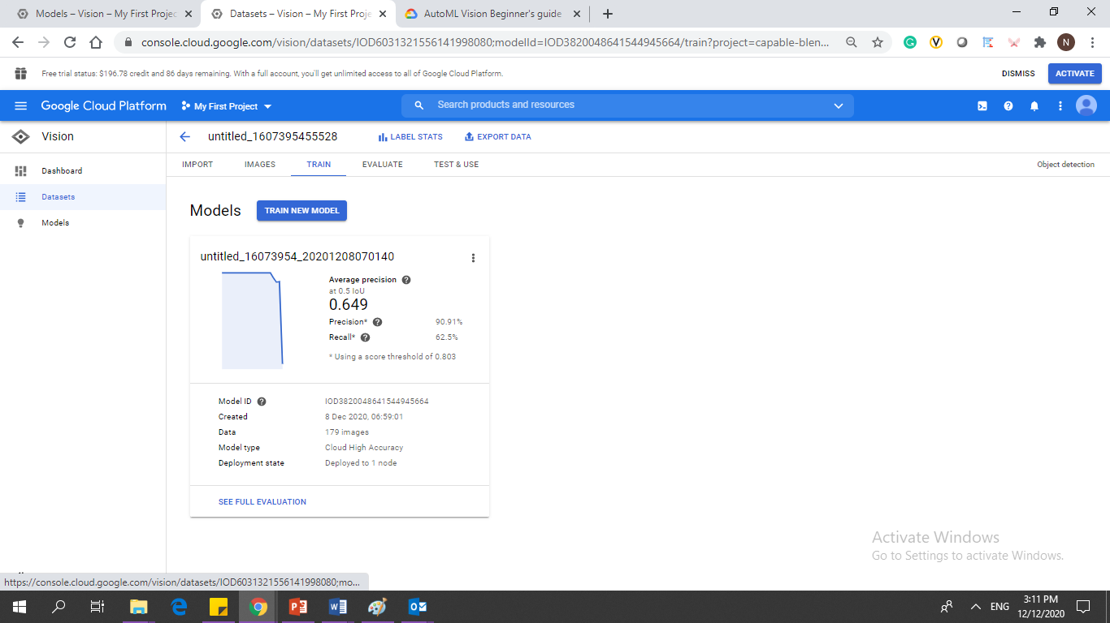
Analyze Data
(AI)
Cloud AutoML
Batch Image Download Full Screen Capture

Slide 23

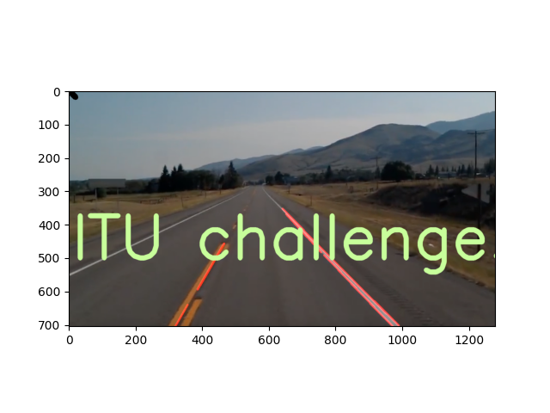
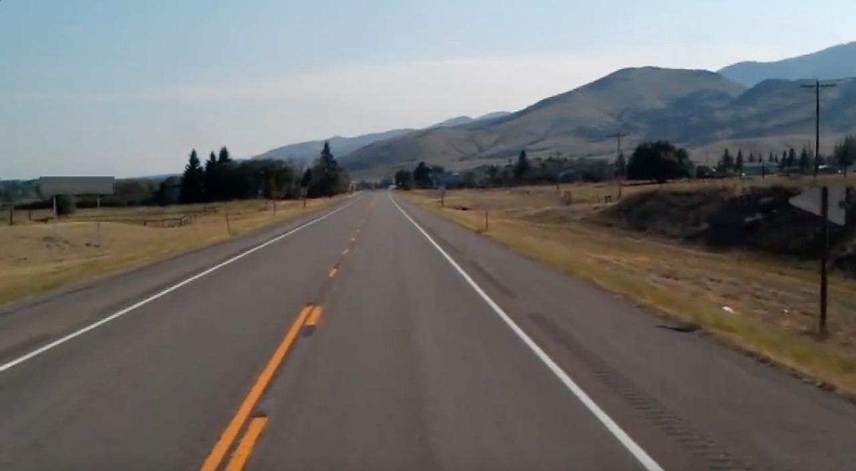
Analyze Data
(AI)
# Hello World program in Python
import matplotlib.pylab as plt
import cv2
import numpy as np
def region_of_interest(img, vertices):
mask = np.zeros_like(img)
#channel_count = img.shape[2]
match_mask_color = 255
cv2.fillPoly(mask, vertices, match_mask_color)
masked_image = cv2.bitwise_and(img, mask)
return masked_image
def drow_the_lines(img, lines):
img = np.copy(img)
blank_image = np.zeros((img.shape[0], img.shape[1], 3), dtype=np.uint8)
for line in lines:
for x1, y1, x2, y2 in line:
cv2.line(blank_image, (x1, y1), (x2, y2), (255, 0, 0), thickness=5)
img = cv2.addWeighted(img, 0.8, blank_image, 1, 0.0)
return img
image = cv2.imread('Road.png')
image = cv2.cvtColor(image, cv2.COLOR_BGR2RGB)
print(image.shape)
height = image.shape[0]
width = image.shape[1]
region_of_interest_vertices = [
(0, height),
(width / 2, height / 2),
(width, height)
]
gray_image = cv2.cvtColor(image, cv2.COLOR_RGB2GRAY)
canny_image = cv2.Canny(gray_image, 100, 200)
cropped_image = region_of_interest(canny_image,
np.array([region_of_interest_vertices], np.int32), )
lines = cv2.HoughLinesP(cropped_image,
rho=6,
theta=np.pi/60,
threshold=160,
lines=np.array([]),
minLineLength=40,
maxLineGap=25)
image_with_lines = drow_the_lines(image, lines)
cv2.line(image_with_lines, (0,0), (20,20), (0,0,0), 15)
font = cv2.FONT_HERSHEY_SIMPLEX
cv2.putText(image_with_lines,'ITU challenge!',(10,500), font, 6, (200,255,155), 13, cv2.LINE_AA)
plt.imshow(image_with_lines)
plt.show()
print("Good jop")
Notes:
# Hello World program in Python
import matplotlib.pylab as plt
import cv2
import numpy as np
def region_of_interest(img, vertices):
mask = np.zeros_like(img)
#channel_count = img.shape[2]
match_mask_color = 255
cv2.fillPoly(mask, vertices, match_mask_color)
masked_image = cv2.bitwise_and(img, mask)
return masked_image
def drow_the_lines(img, lines):
img = np.copy(img)
blank_image = np.zeros((img.shape[0], img.shape[1], 3), dtype=np.uint8)
for line in lines:
for x1, y1, x2, y2 in line:
cv2.line(blank_image, (x1, y1), (x2, y2), (255, 0, 0), thickness=5)
img = cv2.addWeighted(img, 0.8, blank_image, 1, 0.0)
return img
image = cv2.imread('Road.png')
image = cv2.cvtColor(image, cv2.COLOR_BGR2RGB)
print(image.shape)
height = image.shape[0]
width = image.shape[1]
region_of_interest_vertices = [
(0, height),
(width / 2, height / 2),
(width, height)
]
gray_image = cv2.cvtColor(image, cv2.COLOR_RGB2GRAY)
canny_image = cv2.Canny(gray_image, 100, 200)
cropped_image = region_of_interest(canny_image,
np.array([region_of_interest_vertices], np.int32), )
lines = cv2.HoughLinesP(cropped_image,
rho=6,
theta=np.pi/60,
threshold=160,
lines=np.array([]),
minLineLength=40,
maxLineGap=25)
image_with_lines = drow_the_lines(image, lines)
cv2.line(image_with_lines, (0,0), (20,20), (0,0,0), 15)
font = cv2.FONT_HERSHEY_SIMPLEX
cv2.putText(image_with_lines,'ITU challenge!',(10,500), font, 6, (200,255,155), 13, cv2.LINE_AA)
plt.imshow(image_with_lines)
plt.show()
print("Good jop")

Slide 24
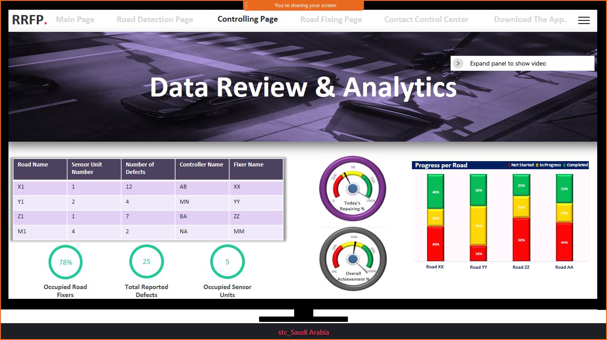
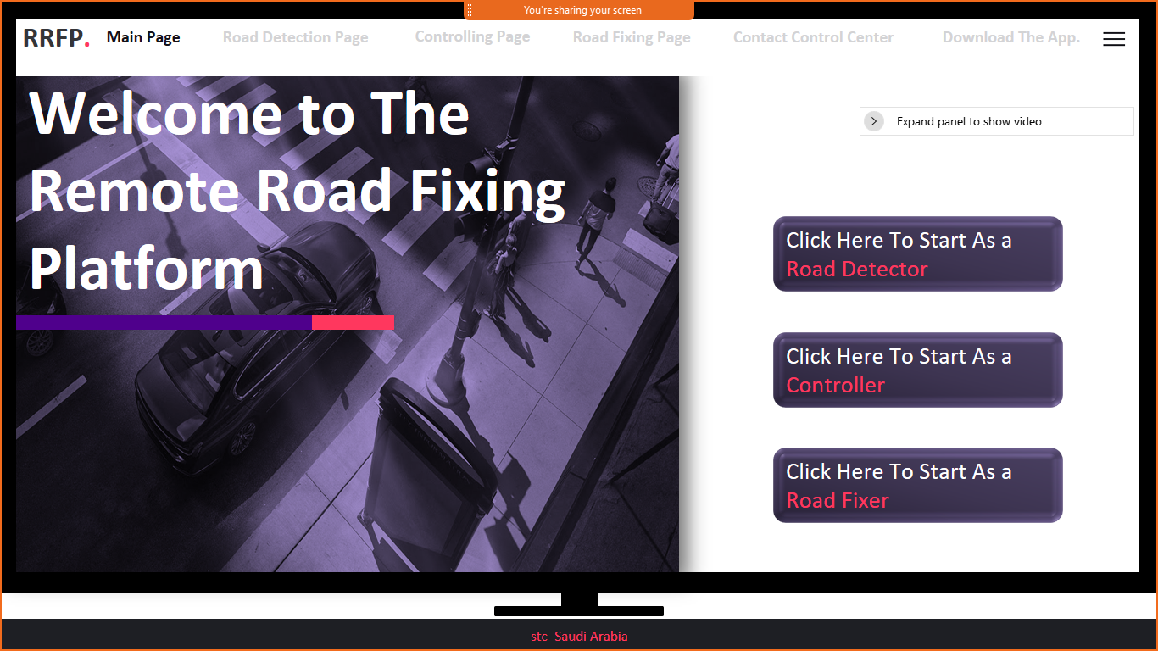
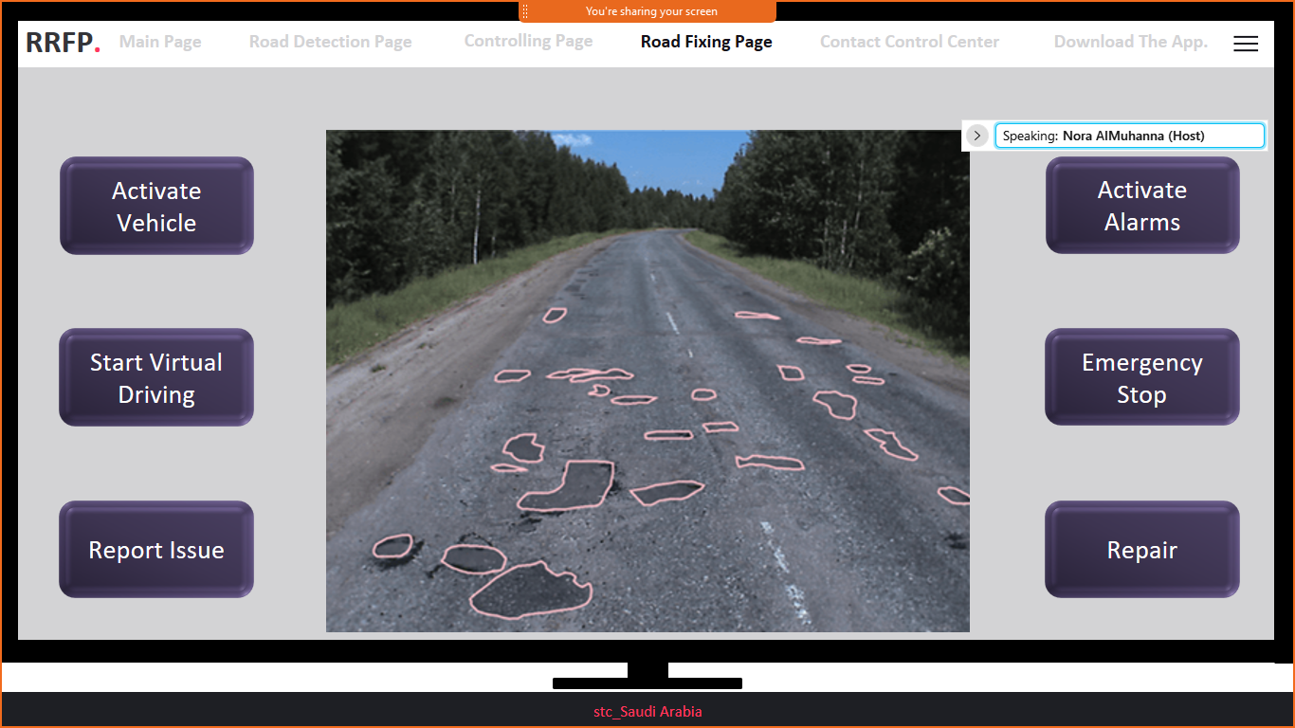
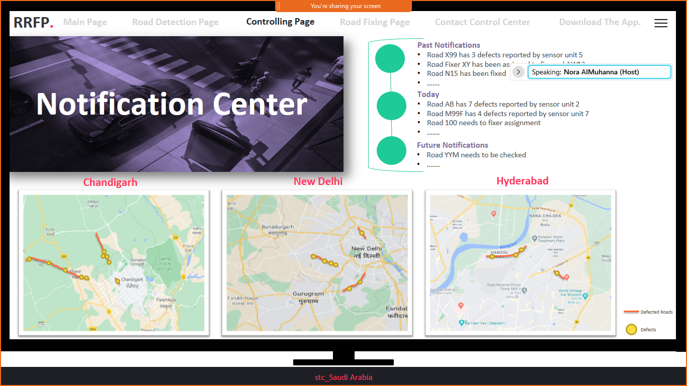
Platform
Demo

Slide 25
AGENDA
Challenge description
1
Solution
2
System design & data set
3
Relevance with automotive industry
4

Slide 26
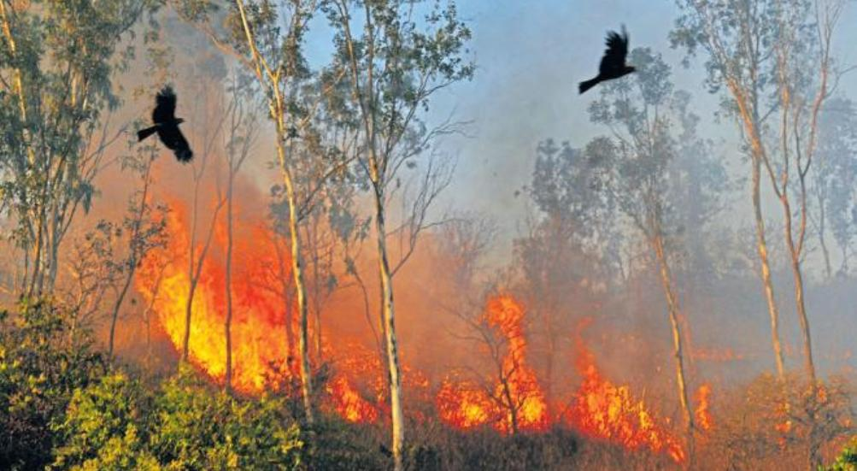
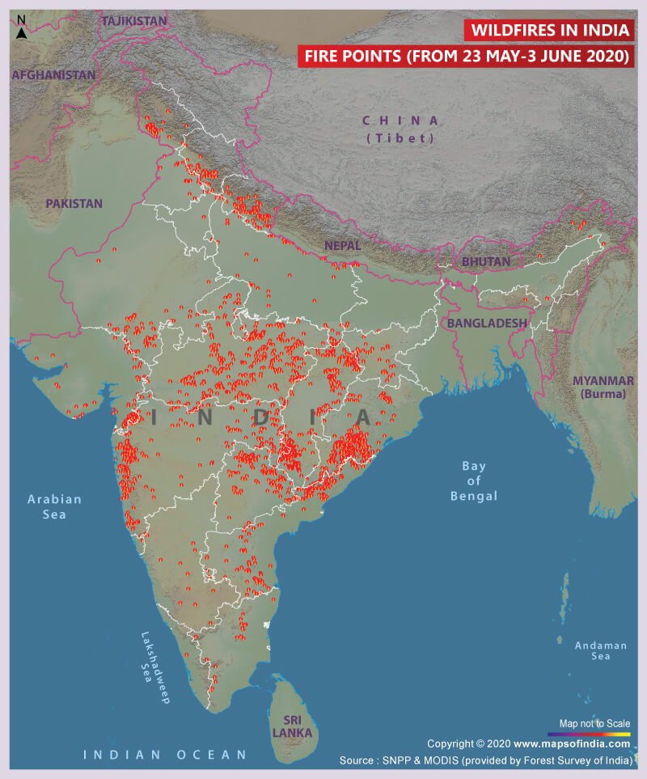

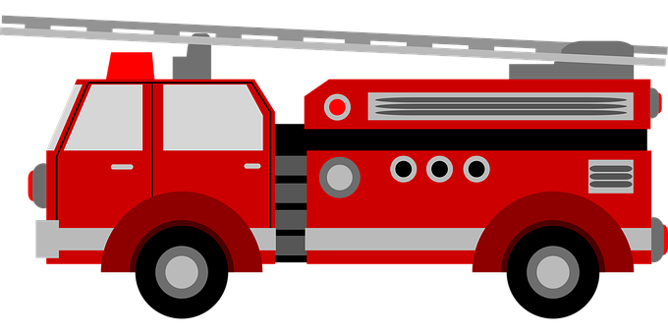
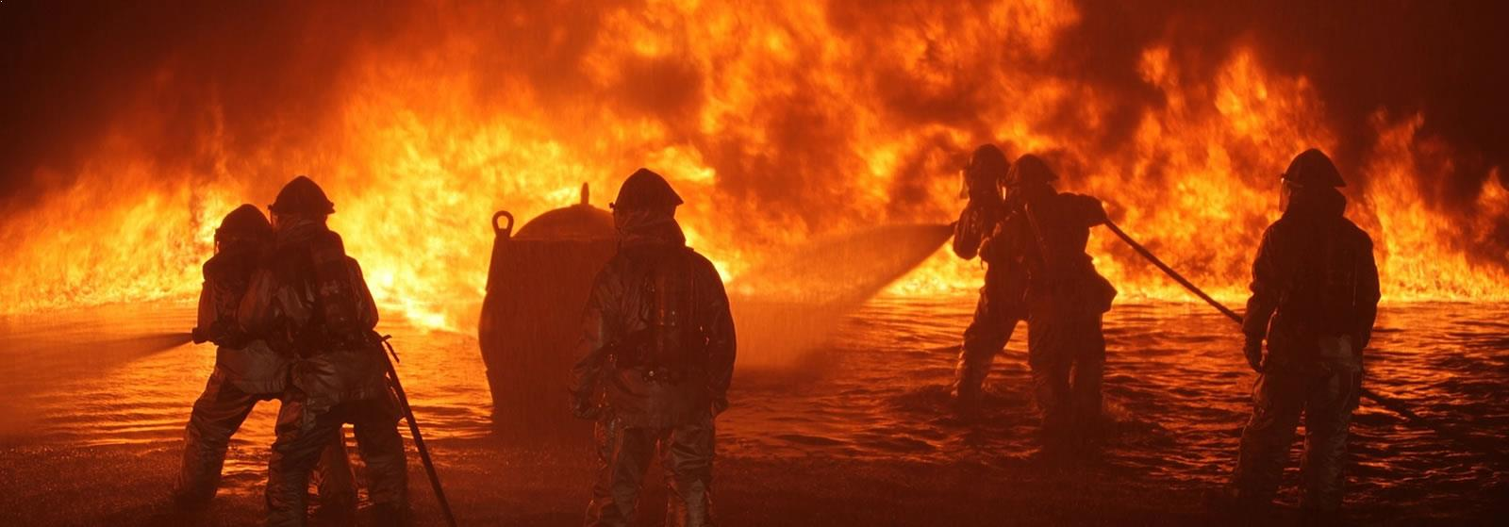
Relevance with Indian automotive industry
How the solution can benefit in a large scale automotive Industry?
Remote-control and monitor
Fire Engine Truck
Commercial truck
Map depicting wildfires in India
Fire points from 23 May -3 Jun2 2020
Source:
https://www.mapsofindia.com/answers/india/is-it-time-for-india-to-condsider-a-national-wildfire-policy-framework/

Slide 27
END
THANK YOU
ITU AI/ML in 5G Challenge
Smart Transportation

Slide 28
SOLUTION
AT GLANCE
Challenges
01
New machines & vehicle support 5G network.
02
Real data availability to train the AI model.
03
New regulations for remote driving.

Slide 29
Pert Chart
4
Concept development
Challenge selection and brainstorming
Idea generation and screening
Quality / Feasibility / Ability Test
t = 1 week
System analysis and design
Start demo
1
2
3
6
7
8
t = 1 week
t = 1 week
Business analysis
t = 2 weeks
t = 2 weeks
t = 1 week
t = 1 week
5
Solution Developed Type
The solution development type is an algorithm to use 5G and AI in repairing road defects while using control centers, remote driving vehicles, and cams using mobile app

Slide 30

PROJECT
MILESTONE
Timeline
Challenge selection and brainstorming
Idea generation and screening
1
2
System analysis and design
Business analysis
5
4
3
Concept development
5th Oct
First submission
6
7
8
Start demo
15th Oct Final submission

Slide 31
AGENDA
Description of the project
1
Requirements analysis &methodology
2
Evaluation setup& timeline
3
Demonstration
4
Team dynamic
5
Relevance with automotive industry
6

Slide 32
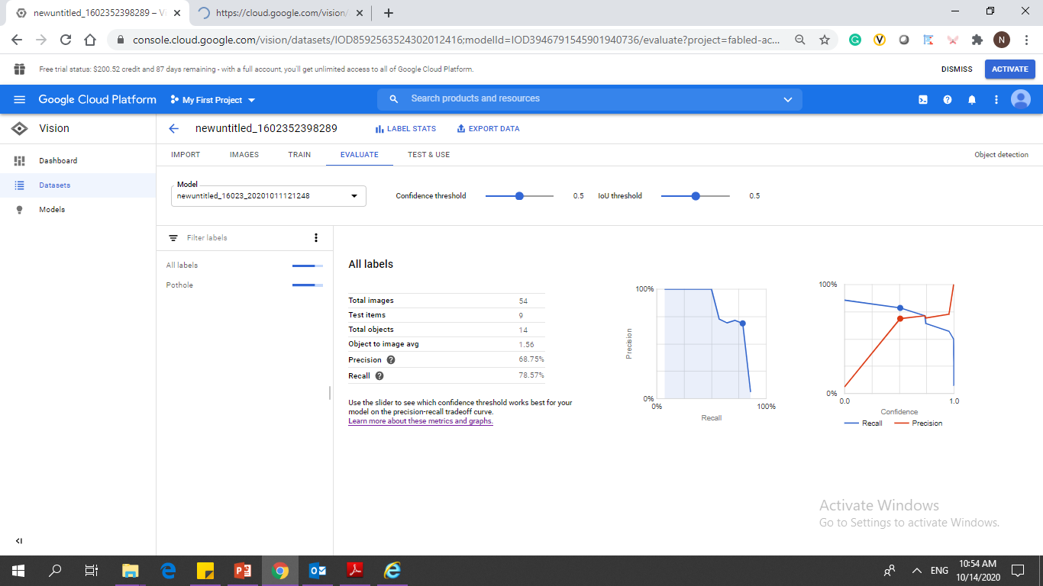
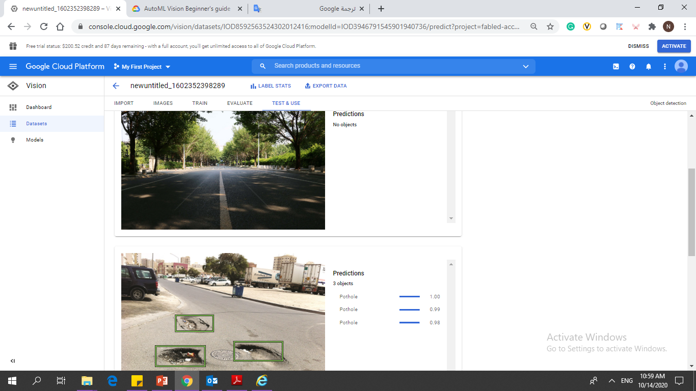
Analyze Data
(AI)

Slide 33
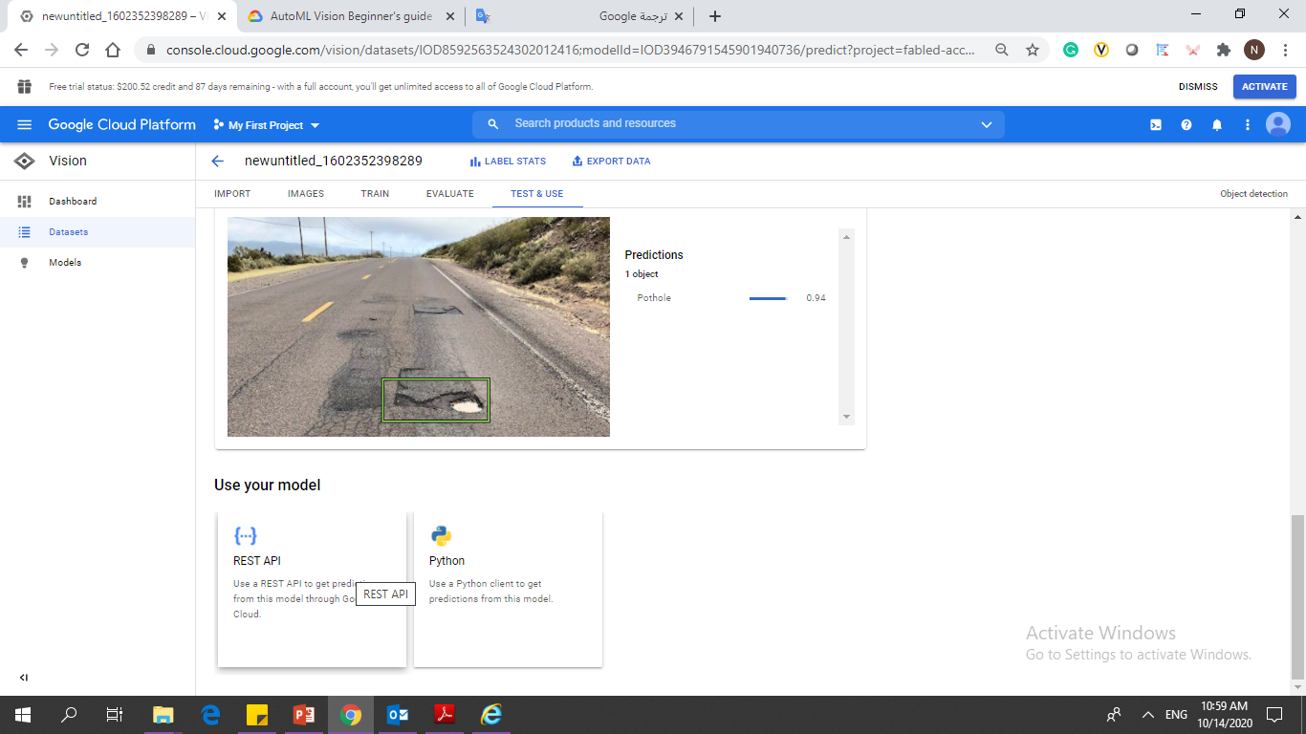
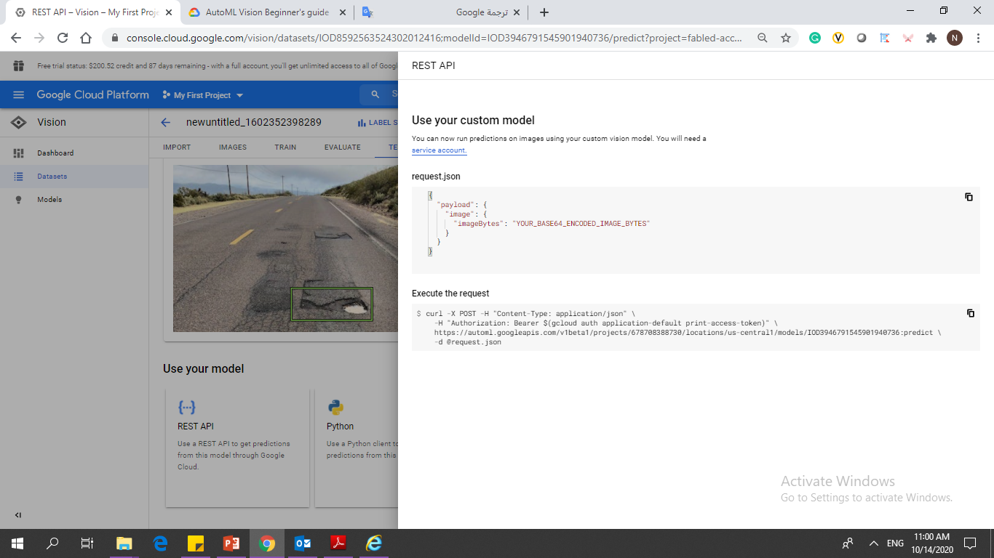
Analyze Data
(AI)
{
"payload": {
"image": {
"imageBytes": "YOUR_BASE64_ENCODED_IMAGE_BYTES"
}
}
}
curl -X POST -H "Content-Type: application/json" \
-H "Authorization: Bearer $(gcloud auth application-default print-access-token)" \
https://automl.googleapis.com/v1beta1/projects/678708388730/locations/us-central1/models/IOD3946791545901940736:predict \
-d @request.json

Slide 34
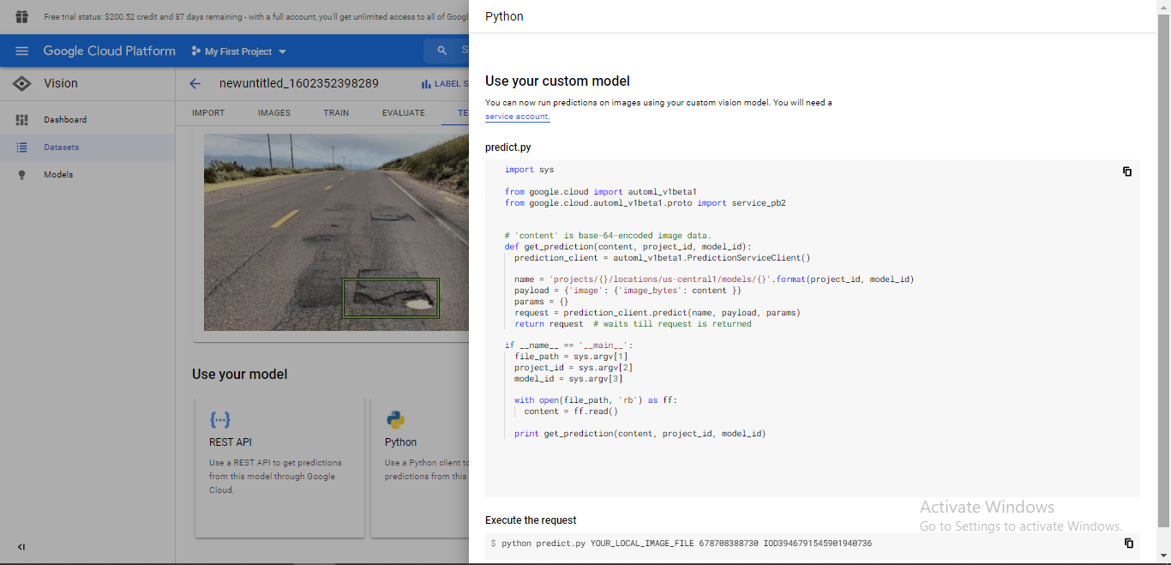
Analyze Data
(AI)
import sys
from google.cloud import automl_v1beta1
from google.cloud.automl_v1beta1.proto import service_pb2
# 'content' is base-64-encoded image data.
def get_prediction(content, project_id, model_id):
prediction_client = automl_v1beta1.PredictionServiceClient()
name = 'projects/{}/locations/us-central1/models/{}'.format(project_id, model_id)
payload = {'image': {'image_bytes': content }}
params = {}
request = prediction_client.predict(name, payload, params)
return request # waits till request is returned
if __name__ == '__main__':
file_path = sys.argv[1]
project_id = sys.argv[2]
model_id = sys.argv[3]
with open(file_path, 'rb') as ff:
content = ff.read()
print get_prediction(content, project_id, model_id)
python predict.py YOUR_LOCAL_IMAGE_FILE 678708388730 IOD3946791545901940736

Slide 35
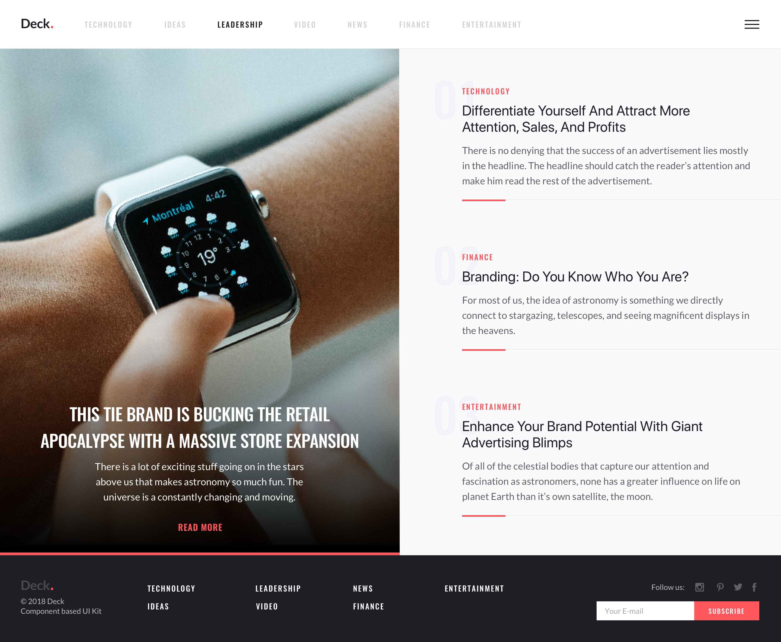
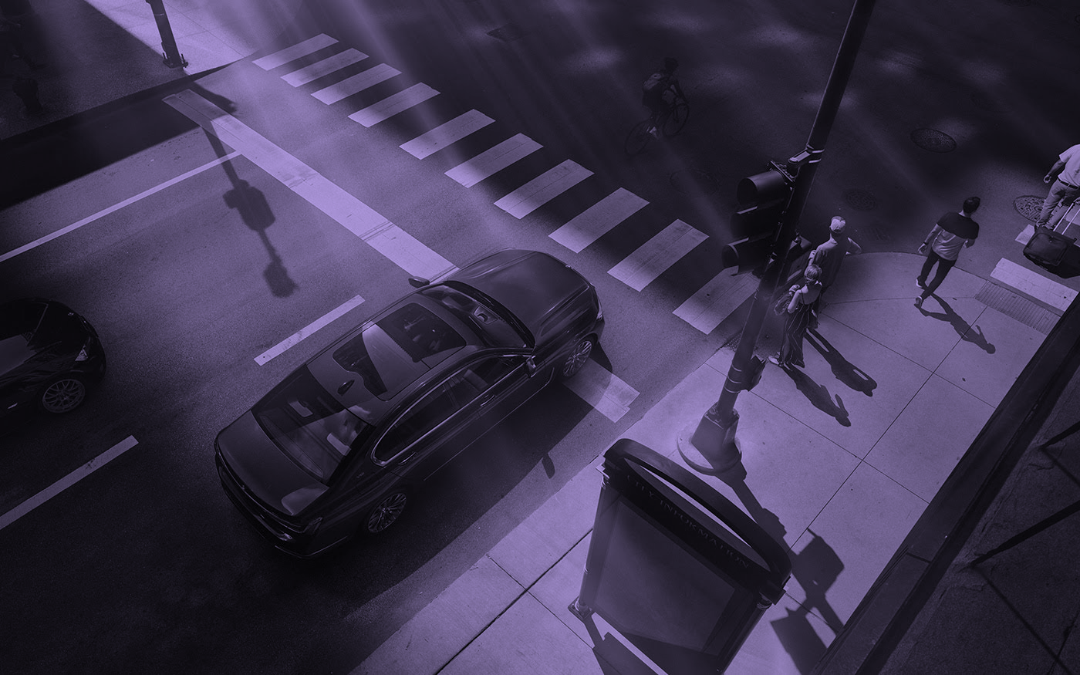
RRFP.
Main Page
Road Detection Page
Controlling Page
Road Fixing Page
Contact Control Center
Download The App.
Welcome to The Remote Road Fixing Platform
Click Here To Start As a Road Detector
Click Here To Start As a Controller
Click Here To Start As a Road Fixer

Slide 36
RRFP.
Main Page
Road Detection Page
Controlling Page
Road Fixing Page
Contact Control Center
Download The App.
Road Detection Page
Automatically activate the sensor unit
Manually activate the sensor & send the date
Review the collected data of sensor unit

Slide 37
RRFP.
Road Detection Page
It will be available as an application to detect defects from cameras and sensor units
Automatically activate the sensor unit
Manually activate the sensor & send the date
Review the collected data of sensor unit

Slide 38
RRFP.
Main Page
Road Detection Page
Controlling Page
Road Fixing Page
Contact Control Center
Download The App.
Notification Center
Control Center
Data Review & Analytics
Road Fixing Assignment

Slide 39
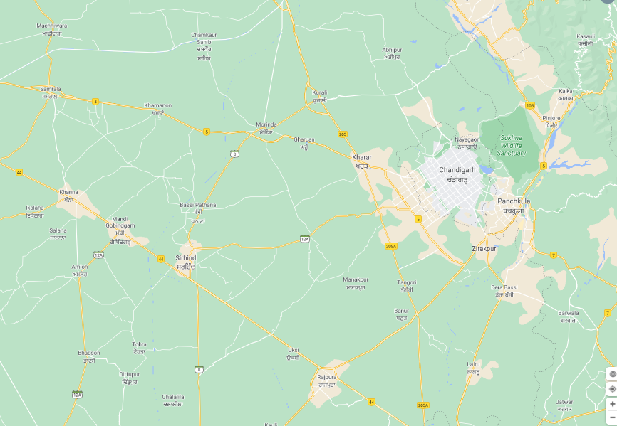
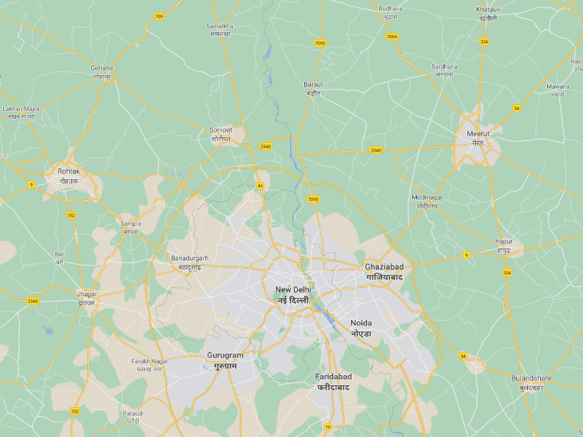
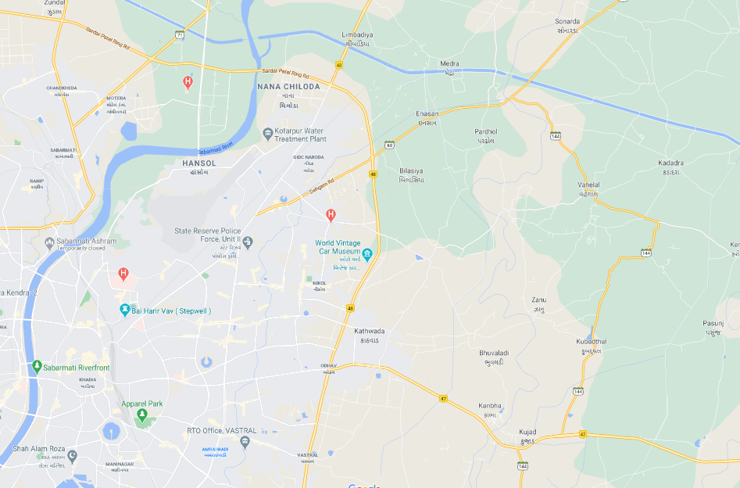
RRFP.
Main Page
Road Detection Page
Controlling Page
Road Fixing Page
Contact Control Center
Download The App.
Past Notifications
Road X99 has 3 defects reported by sensor unit 5
Road Fixer XY has been assigned to fix road AW12
Road N15 has been fixed
…….
Notification Center
Today
Road AB has 7 defects reported by sensor unit 2
Road M99F has 4 defects reported by sensor unit 7
Road 100 needs to fixer assignment
…….
Future Notifications
Road YYM needs to be checked
…....
Chandigarh
New Delhi
Hyderabad
Defected Roads
Defects

Slide 40
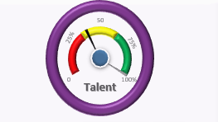
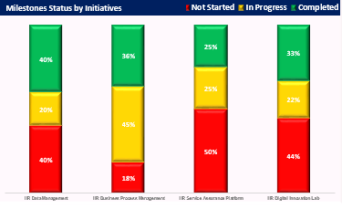
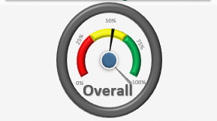
RRFP.
Main Page
Road Detection Page
Controlling Page
Road Fixing Page
Contact Control Center
Download The App.
Data Review & Analytics
Road Name | Sensor Unit Number | Number of Defects | Controller Name | Fixer Name
X1 | 1 | 12 | AB | XX
Y1 | 2 | 4 | MN | YY
Z1 | 1 | 7 | BA | ZZ
M1 | 4 | 2 | NA | MM
Progress per Road
Today’s Repairing %
78%
25
5
Overall Achievement %
Road XX
Road YY
Road ZZ
Road AA
Occupied Road Fixers
Total Reported Defects
Occupied Sensor Units

Slide 41
RRFP.
Main Page
Road Detection Page
Controlling Page
Road Fixing Page
Contact Control Center
Download The App.
Road Fixing Assignment
Norah
Abdullah
Abdulrahman
Atheer
Road Name | Sensor Unit Number | Number of Defects | Controller Name | Fixer Name
F1 | 1 | 5 | AB | Click to Assign
G1 | 5 | 2 | AB | Click to Assign
L1 | 3 | 9 | AB | Click to Assign

Slide 42
RRFP.
Main Page
Road Detection Page
Controlling Page
Road Fixing Page
Contact Control Center
Download The App.
F1
Road
Road Fixing Task Details
M97
Vehicle
There are a total of 4 defects
Defects
Start to drive the remote fixing vehicle

Slide 43
RRFP.
Main Page
Road Detection Page
Controlling Page
Road Fixing Page
Contact Control Center
Download The App.
Activate Vehicle
Activate Alarms
Start Virtual Driving
Emergency Stop
Report Issue
Repair

Slide 44
AGENDA
Description of the project
1
Requirements analysis &methodology
2
Evaluation setup& timeline
3
Demonstration
4
Team dynamic
5
Relevance with automotive industry
6

Slide 45
TEAM
DYNAMIC
Market researcher
Strong analytical skills
Networking Engineer
Excellent documentation skills
NORA
ABDULRAHMAN
Technical
Research
Work division
AI
Artificial intelligence
5G
Technology
Solution Developer
Excellent organizer
User Experience
Business strategists
Good communication skills
ATHEER
ABDULLAH
NAME
Work division
Key strengths of team member

